Slide 1

Online Flight Booking System
Anukrama Poudyal

Slide 2
Introduction
The Online Flight Booking System is a project that will assist the airline ticket booking industry in providing its customers with a simple and automated online processing system.
All flight schedules, airline information, and flight details will be stored in the system by the admin, and this data will be filtered according to the client's chosen schedule to book on the website.
All flight schedules, airline information, and flight details will be stored in the system by the admin, and this data will be filtered according to the client's chosen schedule to book on the website.

Slide 3
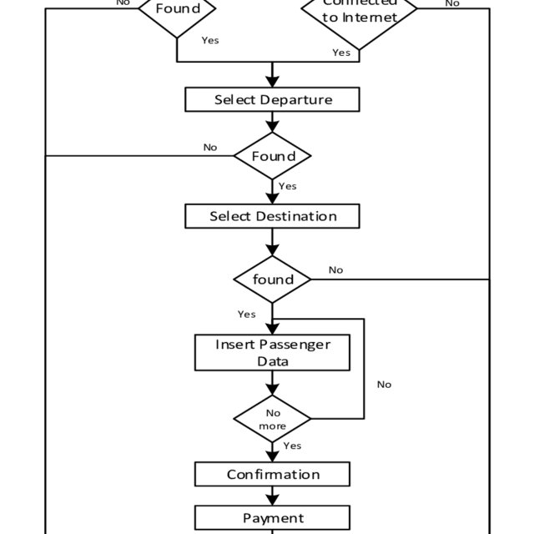
Flowchart of the program

